Slide 1
Disagreement in the Church:
The Councils of
Second Ephesus
and
Chalcedon

Slide 2
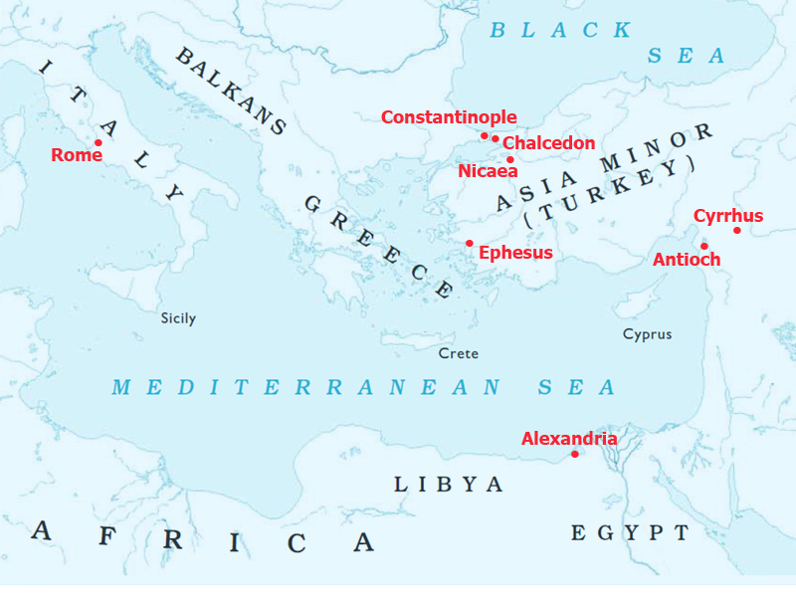

Slide 3
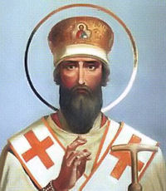
Flavian, bishop of Constantinople

Slide 4
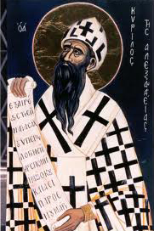
Theodosius II, emperor of Eastern Roman Empire

Slide 5
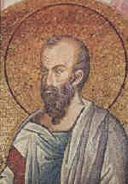
Theodoret, bishop of Cyrrhus

Slide 6
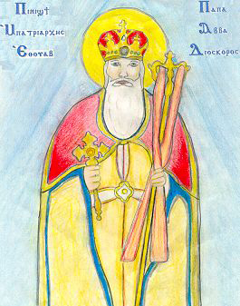
Dioscorus, bishop of Alexandria

Slide 7
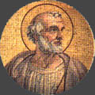
Leo, bishop of Rome

Slide 8
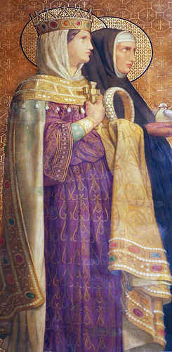
Pulcheria, empress of Eastern Roman Empire

Slide 9
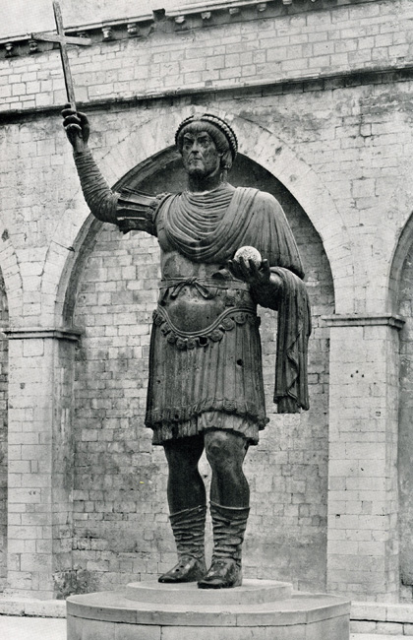
Marcian, emperor of Eastern Roman Empire

Slide 10
We, then, following the holy Fathers, all with one consent, teach people to confess one and the same Son, our Lord Jesus Christ, the same perfect in Godhead and also perfect in manhood; truly God and truly man, of a reasonable [rational] soul and body; consubstantial [co-essential] with the Father according to the Godhead, and consubstantial with us according to the Manhood; in all things like unto us, without sin; begotten before all ages of the Father according to the Godhead, and in these latter days, for us and for our salvation, born of the Virgin Mary, the Mother of God, according to the Manhood; one and the same Christ, Son, Lord, only begotten, to be acknowledged in two natures, inconfusedly, unchangeably, indivisibly, inseparably; the distinction of natures being by no means taken away by the union, but rather the property of each nature being preserved, and concurring in one Person and one Subsistence, not parted or divided into two persons, but one and the same Son, and only begotten God, the Word, the Lord Jesus Christ; as the prophets from the beginning [have declared] concerning Him, and the Lord Jesus Christ Himself has taught us, and the Creed of the holy Fathers has handed down to us.

Slide 11
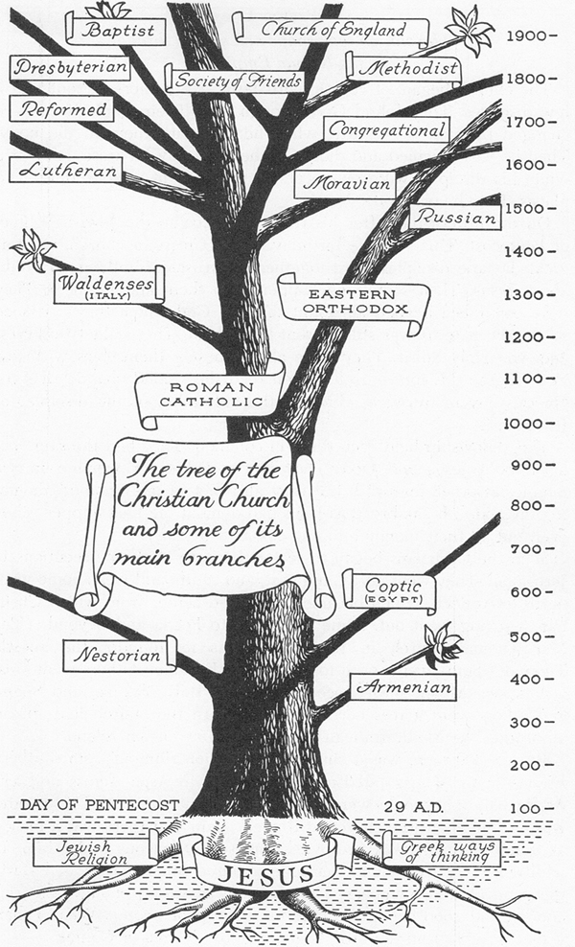

Slide 12
Today’s non-Chalcedonian Churches
Coptic Orthodox
Ethiopian Orthodox
Eritrean Orthodox
Syriac Orthodox
Malakara Orthodox Syrian (India)
Armenian Apostolic

Slide 13
Would we ever have such a series of events at Bethlehem?

Slide 14
Minutes of called meeting on 02/15/1902 (Deacon A [who became a charter member of Berea less than 3 months later] presiding since Rev. Holt could not travel there because of snow):
"On motion the secretary being absent was sent for. Secretary arrived minutes of last meeting read and approved. On motion the report of the deacons was called for. Deacons report read as follows:
We the deacons to investigate the charges vs. Bro X beg leave to make the following report. That the said Bro X evades the questions in regard to the letters written our pastor but treats us with contempt refusing to answer our questions. We the deacons sincerely believe that Bro X is guilty of the charges the rumor preferred and believe that Bro X is due the Church an apology and would recommend that the Church further proceed with the matter in a Christian Spirit. Signed by B, C, D, and E.
On motion the Deacons' report was rejected. Miss Y [who became a charter member of Berea less than 3 months later] offered the following resolution which was adopted. Whereas X has been maliciously accused of and arraigned for anonymous letter writing, therefore resolved that he hereby be exonerated and all former proceedings and actions of same shall be expunged from the Church record. On motion of Z, Rev. J. W. Holt was asked for his resignation as pastor of Bethlehem Church."

Slide 15
Minutes of regularly scheduled quarterly meeting on 04/19/1902 (Rev. P. H. Fleming presiding):
"Minutes of the last regular conference read and adopted. Minutes of the called conference read and declared by the chair to be the proceedings of a called meeting legally held by Deacon A 02/15/1902 Corrected and Approved. The following resolution was offered by F and adopted. Whereas the proceedings of this church in called conference on 02/15/1902 were revolutionary and not the general sentiment of the membership of this church. Be it resolved that the entire proceedings of said called conference be nullified.

Slide 16
On motion the report of the deacons dated February the 1st 1902 was read. Deacons report adopted. On motion the Church proceeded through its deacons to sustain the charges preferred in deacons report. Deacons report of 04/19/1902 reads as follows: We the undersigned deacons of Bethlehem Church Report that whereas Bro. X has given us a great deal of trouble by sowing discord among the brethren using his influence to prejudice them against each other and more especially to prejudice a faction against our pastor and has further made himself troublesome by trespassing on our church property, we recommend that this church require him to correct his mistakes or suspend him until he gives sufficient evidence of reformation … Signed by B,C,E,D, and F... Report adopted. On motion of G the charges were sustained by the church, voting the judgment that Bro X either wrote, dictated, or knew of the writing of said anonymous letters."

Slide 17
How should the church handle controversy?
What issues, if any, are important enough to split over?

